Slide 1
Lecture -25-26
Dynamics
Part-I: Kinematics
Part-II: Kinetics

Slide 2
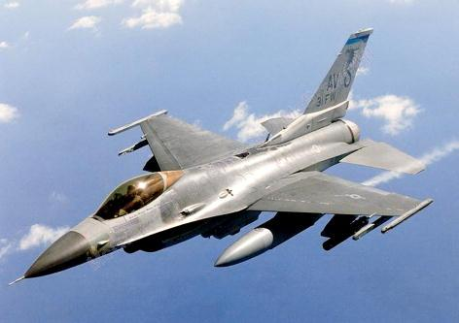
Introduction
Dynamics:
Kinematics: Study of the geometry of motion.
Relates displacement, velocity, acceleration, and time without reference to the cause of motion.
Kinetics:Study of the relations existing between the forces acting on a body, the mass of the body, and the motion of the body. Kinetics is used to predict the motion caused by given forces or to determine the forces required to produce a given motion.
F_{thrust}
F_{drag}
F_{lift}

Slide 3
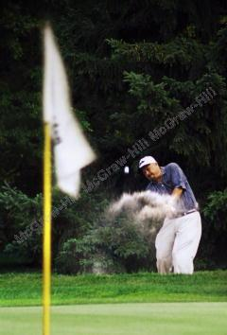
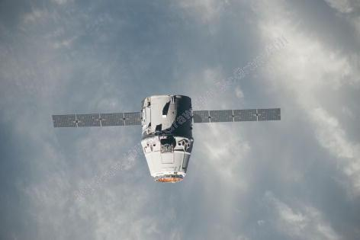
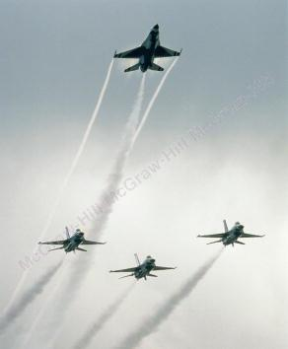
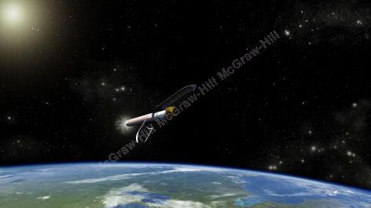
Introduction
Kinematics is the branch of dynamics which describes the motion of bodies without reference to the forces which either causes the motion or are generated as a result of motion.
It is the study of the relationship between displacement , velocity and acceleration and time of a given motion without considering the force that causes motion.
Applications: Design of cam, gear, linkage, trajectory of air craft, etc.

Slide 4
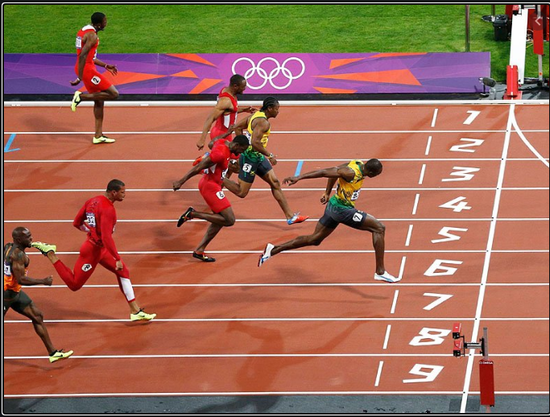
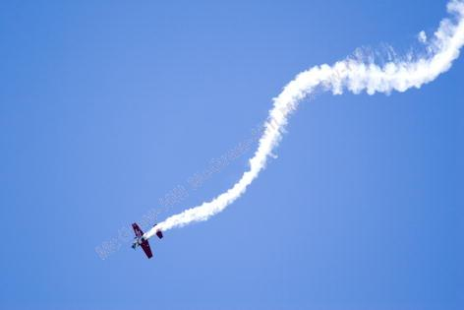
Particle Dynamics
Rectilinear motion:
Position, velocity, and acceleration of a particle as it moves along a straight line.
Curvilinear motion:
Position, velocity, and acceleration of a particle as it moves along a curved line in two or three dimensions.

Slide 5
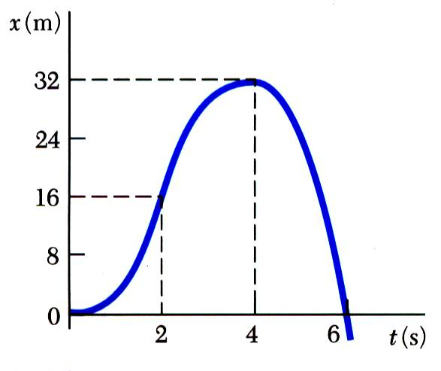
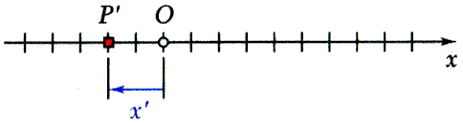
Rectilinear motion: position, velocity and acceleration
Rectilinear motion: particle moving along a straight line
Position coordinate: defined by positive or negative distance from a fixed origin on the line.
The motion of a particle is known if the position coordinate for particle is known for every value of time t.
May be expressed in the form of a function, e.g.,
or in the form of a graph x vs. t.

Slide 6
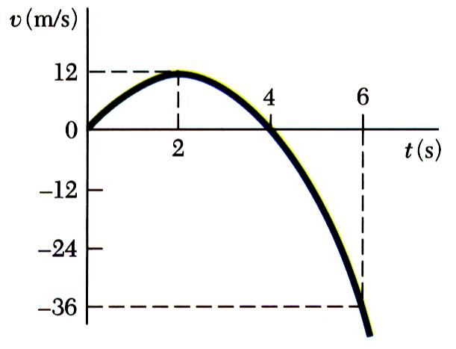
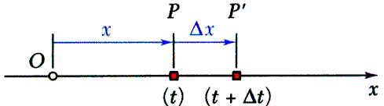
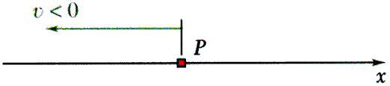
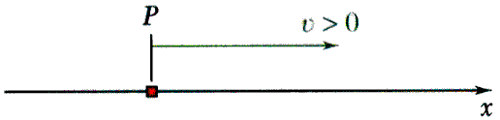
Rectilinear motion: position, velocity and acceleration
Consider particle which occupies position P at time t and P’ at t +Δt,
Average velocity
Instantaneous velocity
Instantaneous velocity may be positive or negative. Magnitude of velocity is referred to as particle speed.
From the definition of a derivative,

Slide 7
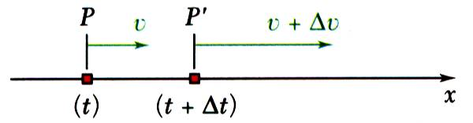
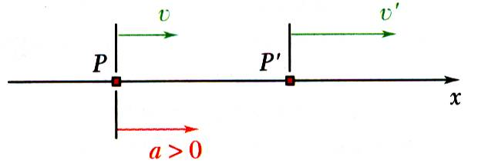
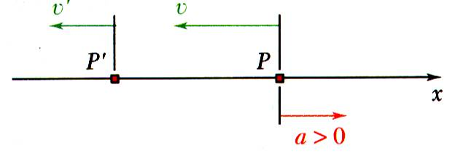
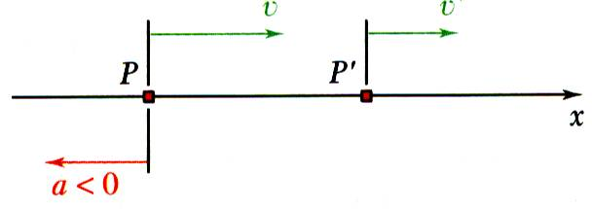
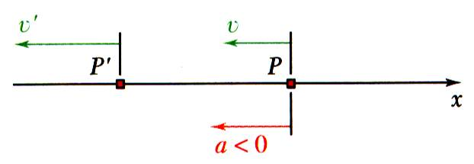
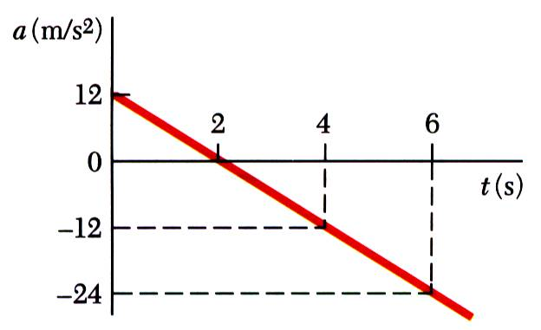
Rectilinear motion: position, velocity and acceleration
Consider particle with velocity v at time t and v’ at t+Δt,
Instantaneous acceleration
Instantaneous acceleration may be:
positive: increasing positive velocity
or decreasing negative velocity
negative: decreasing positive velocity
or increasing negative velocity.
From the definition of a derivative,

Slide 8
Rectilinear motion: position, velocity and acceleration
From our example,
What are x, v, and a at t = 2 s ?
Note that v_{max} occurs when a=0, and that the slope of the velocity curve is zero at this point.
What are x, v, and a at t = 4 s ?

Slide 9
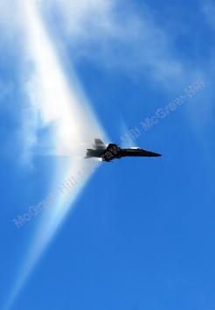
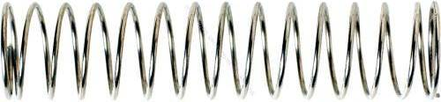
Determination of motion of particle
We often determine accelerations from the forces applied (kinetics will be covered later)
Generally have three classes of motion
acceleration given as a function of time, a = f(t)
- acceleration given as a function of position, a = f(x)
- acceleration given as a function of velocity, a = f(v)
Force is a function of position?
When force is a function of velocity?
a spring
drag

Slide 10
Acceleration as a function of time, position and velocity
If….
Kinematic relationship
Integrate

Slide 11
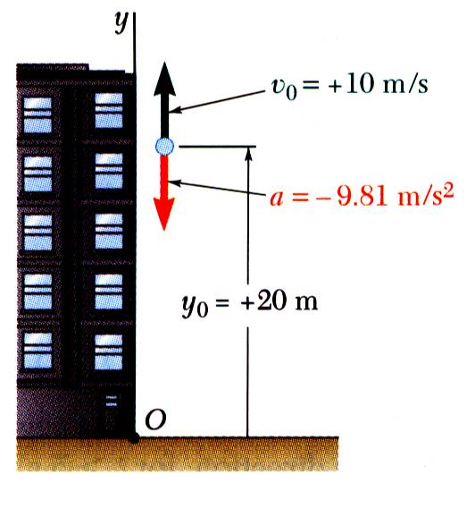
Problem 1
Ball tossed with 10 m/s vertical velocity from window 20 m above ground.
Determine:
(a) velocity and elevation above ground at time t , (b) highest elevation reached by ball and corresponding time, and (c) time when ball will hit the ground and corresponding velocity.

Slide 12
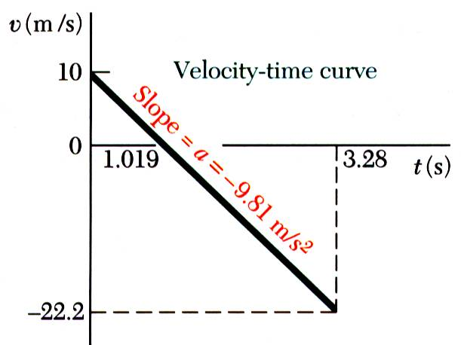
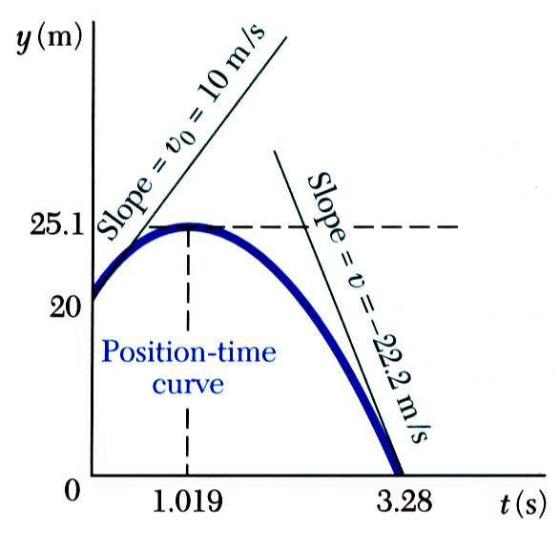
Problem 1
SOLUTION:
Integrate twice to find v(t) and y(t).

Slide 13
Problem 1
Solve for t when velocity equals zero and evaluate corresponding altitude.
Solve for t when altitude equals zero and evaluate corresponding velocity.

Slide 14
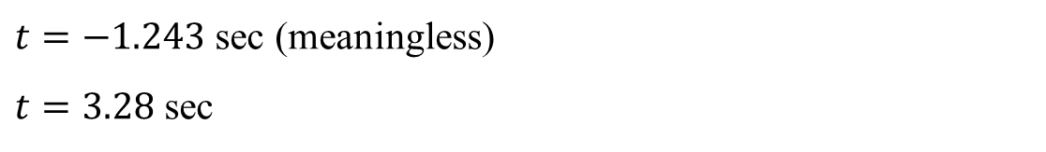
Problem 1
Solve for t when altitude equals zero and evaluate corresponding velocity.
$t=−1.243$ sec (meaningless)
$t=3.28$ sec

Slide 15
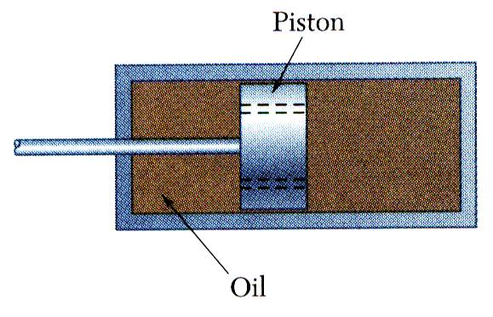
Problem 2
Brake mechanism used to reduce gun recoil consists of piston attached to barrel moving in fixed cylinder filled with oil. As barrel recoils with initial velocity v₀, piston moves and oil is forced through orifices in piston, causing piston and cylinder to decelerate at rate proportional to their velocity.
Determine v(t), x(t), and v(x).

Slide 16
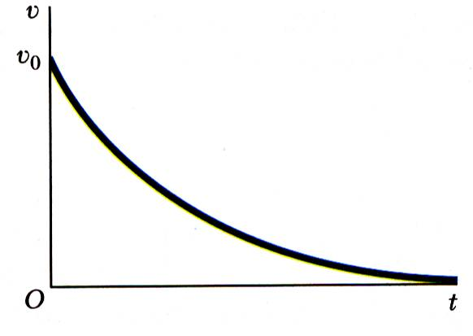
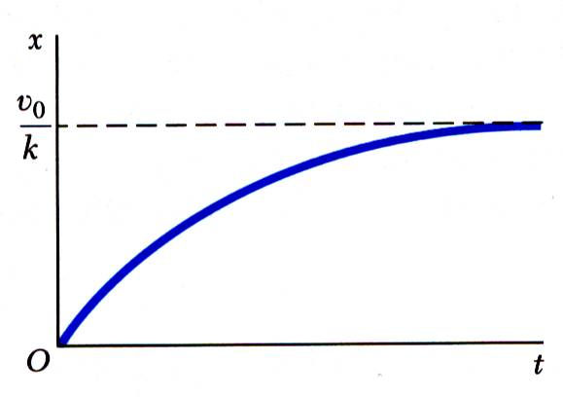
Problem 2
SOLUTION:
Integrate a = dv/dt = -kv to find v(t).
Integrate v(t) = dx/dt to find x(t).

Slide 17
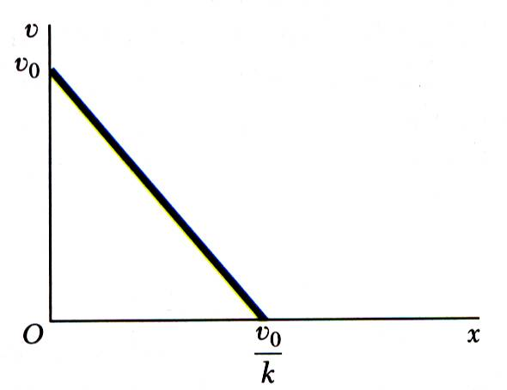
Problem 2
Integrate a = v dv/dx = -kv to find v(x).
Alternatively,
with
and
then

Slide 18
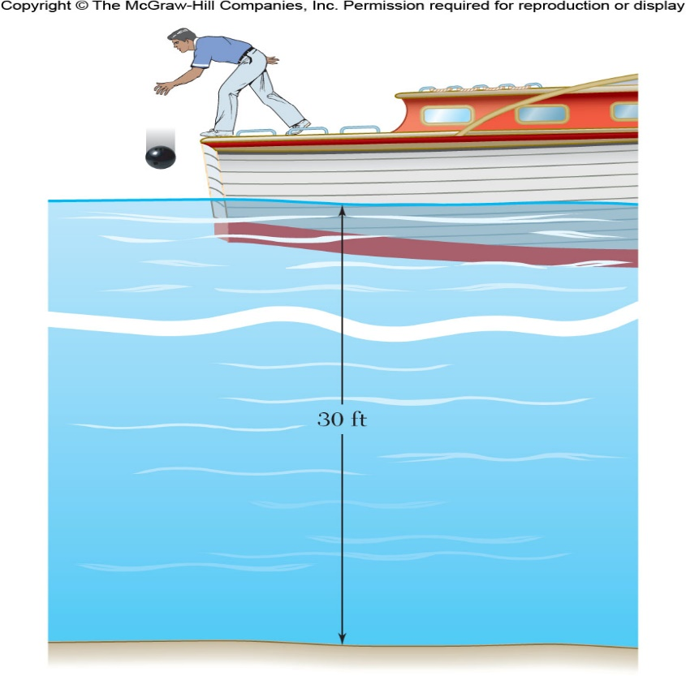
Problem 3
A bowling ball is dropped from a boat so that it strikes the surface of a lake with a speed of 15 ft/s. Assuming the ball experiences a downward acceleration of a =10 - 0.01v² when in the water, determine the velocity of the ball when it strikes the bottom of the lake.
The velocity would have to be high enough for the 0.01 v² term to be bigger than 10

Slide 19
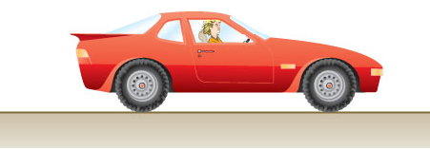
Problem 4
The car starts from rest and accelerates according to the relationship
v_{o} = 0, r = 200 m
It travels around a circular track that has a radius of 200 meters. Calculate the velocity of the car after it has travelled halfway around the track. What is the car’s maximum possible speed?
Velocity is a maximum when acceleration is zero

Slide 20
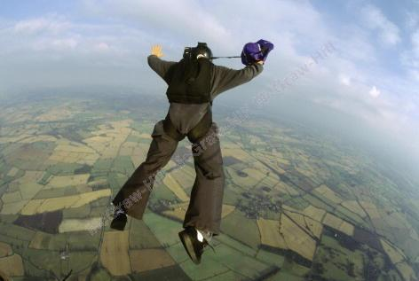
Uniform rectilinear motion
During free-fall, a parachutist reaches terminal velocity when her weight equals the drag force. If motion is in a straight line, this is uniform rectilinear motion.
For a particle in uniform rectilinear motion, the acceleration is zero and the velocity is constant.
Careful – these only apply to uniform rectilinear motion!

Slide 21
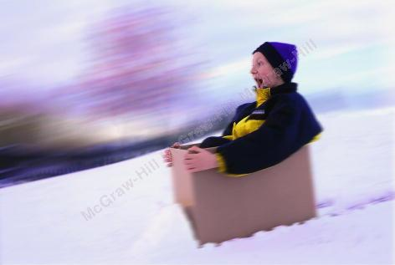
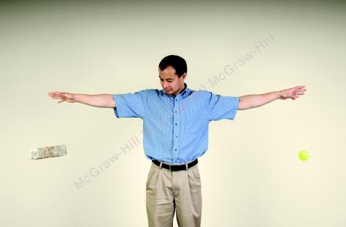
Uniform accelerated rectilinear motion
If forces applied to a body are constant (and in a constant direction), then you have uniformly accelerated rectilinear motion.
Another example is free-fall when drag is negligible.

Slide 22
Uniform accelerated rectilinear motion
For a particle in uniformly accelerated rectilinear motion, the acceleration of the particle is constant. You may recognize these constant acceleration equations from your physics courses.
Careful – these only apply to uniformly accelerated rectilinear motion!

Slide 23
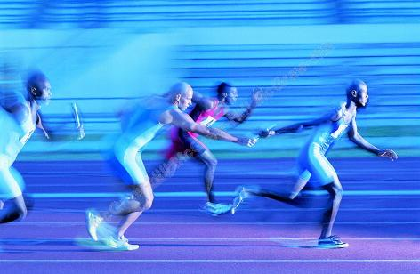
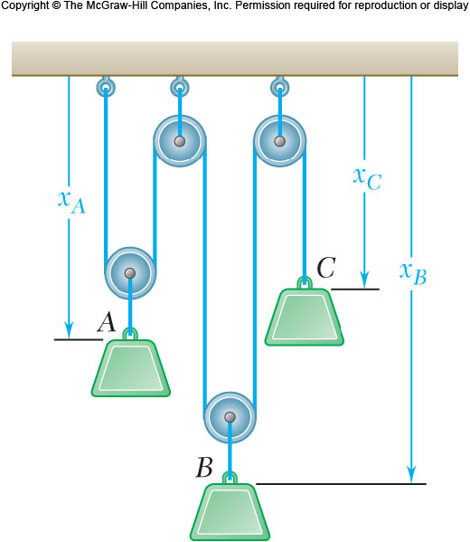
Motion of several particles
We may be interested in the motion of several different particles, whose motion may be independent or linked together.
Independent motion
Dependent motion

Slide 24
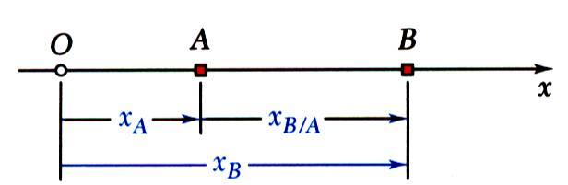
Motion of several particles
For particles moving along the same line, time should be recorded from the same starting instant and displacements should be measured from the same origin in the same direction.
relative position of B with respect to A = relative position of B as observed from A
relative velocity of B with respect to A
relative acceleration of B with respect to A

Slide 25
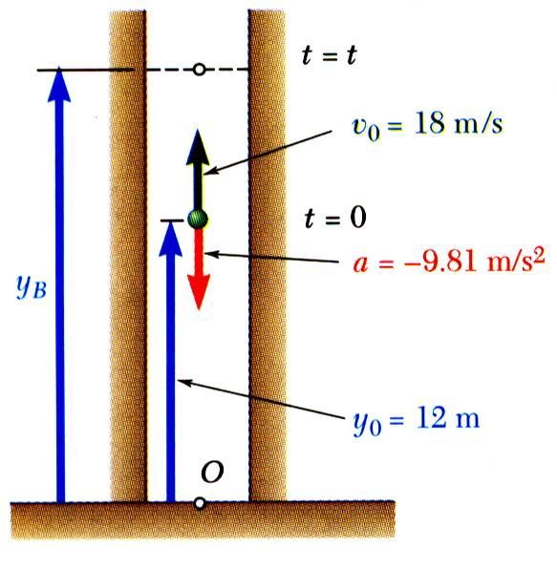
Motion of several particles (independent motion)
Ball thrown vertically from 12 m level in elevator shaft with initial velocity of 18 m/s. At same instant, open-platform elevator passes 5 m level moving upward at 2 m/s.
Determine (a) when and where ball hits elevator and (b) relative velocity of ball and elevator at contact.

Slide 26
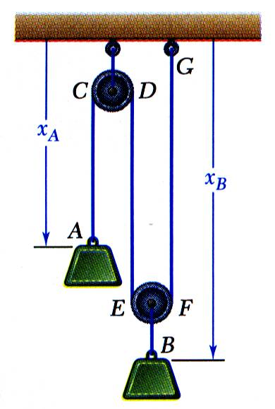
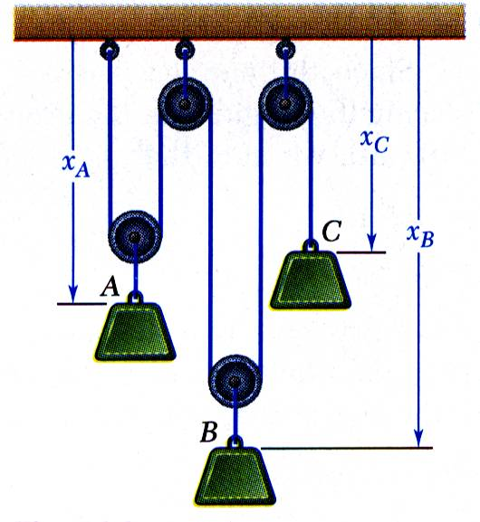
Motion of several particles (dependent motion)
Position of a particle may depend on position of one or more other particles.
Position of block B depends on position of block A. Since rope is of constant length, it follows that sum of lengths of segments must be constant.
constant (one degree of freedom)
Positions of three blocks are dependent.
constant (two degrees of freedom)
For linearly related positions, similar relations hold between velocities and accelerations.

Slide 27
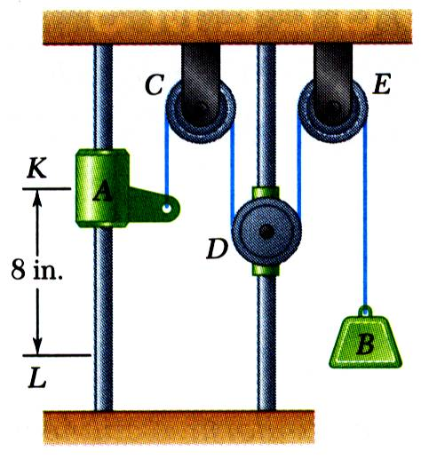
Motion of several particles (dependent motion)
Pulley D is attached to a collar which is pulled down at 3 in./s. At t = 0, collar A starts moving down from K with constant acceleration and zero initial velocity. Knowing that velocity of collar A is 12 in./s as it passes L, determine the change in elevation, velocity, and acceleration of block B when collar A is at L.

Slide 28
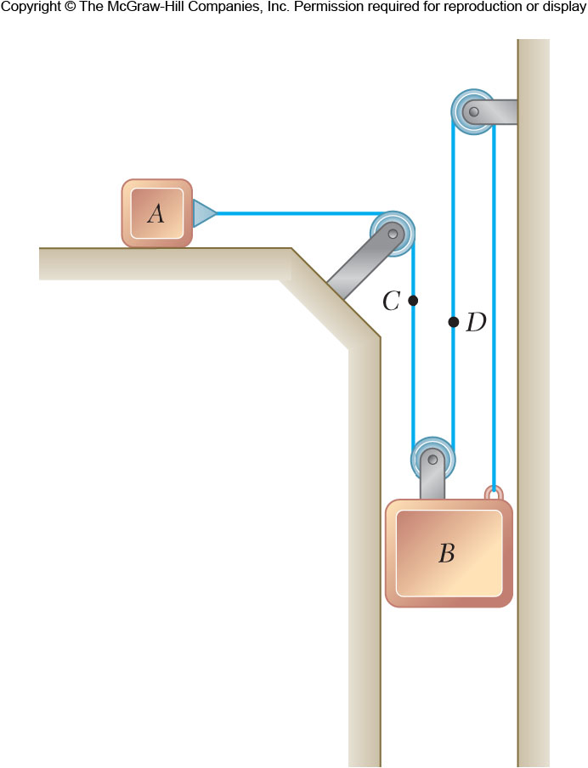
Motion of several particles (dependent motion)
Slider block A moves to the left with a constant velocity of 6 m/s. Determine the velocity of block B.

Slide 29
Graphical solution of rectilinear motion problem
Engineers often collect position, velocity, and acceleration data. Graphical solutions are often useful in analyzing these data.
Acceleration data from a head impact during a round of boxing.

Slide 30
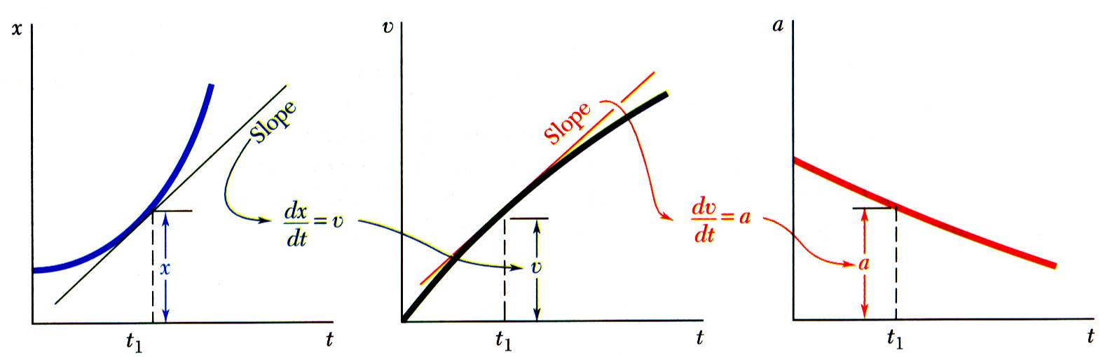
Graphical solution of rectilinear motion problem
Given the x-t curve, the v-t curve is equal to the x-t curve slope.
Given the v-t curve, the a-t curve is equal to the v-t curve slope.

Slide 31
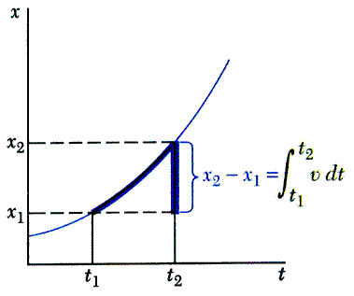
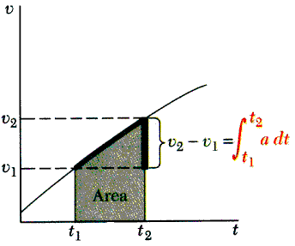
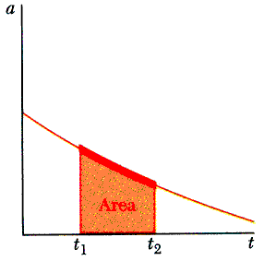
Graphical solution of rectilinear motion problem
Given the a-t curve, the change in velocity between t₁ and t₂ is equal to the area under the a-t curve between t₁ and t₂.
Given the v-t curve, the change in position between t₁ and t₂ is equal to the area under the v-t curve between t₁ and t₂.

Slide 32
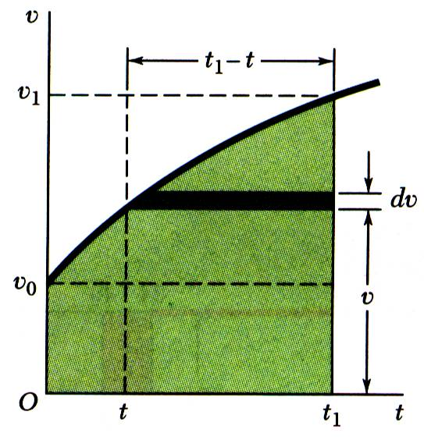
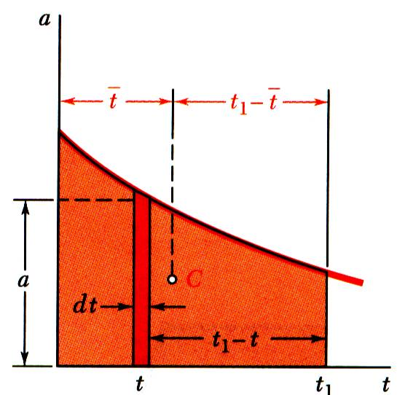
Graphical solution of rectilinear motion problem
Moment-area method to determine particle position at time t directly from the a-t curve:
using dv = a dt ,
first moment of area under a-t curve with respect to t = t₁ line.

Slide 33
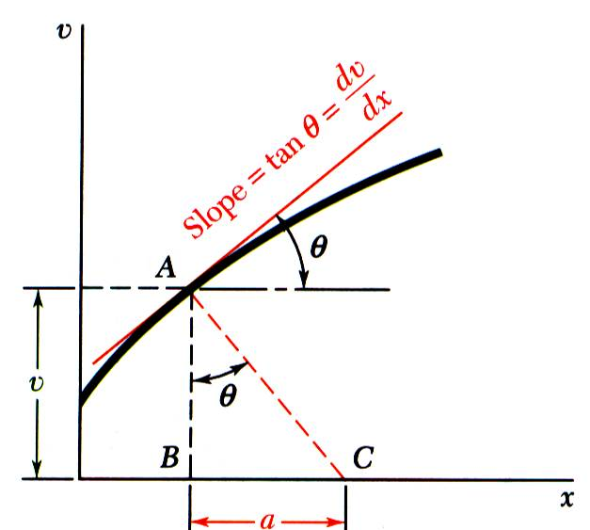
Graphical solution of rectilinear motion problem
Method to determine particle acceleration from v-x curve:
subnormal to v-x curve

Slide 34
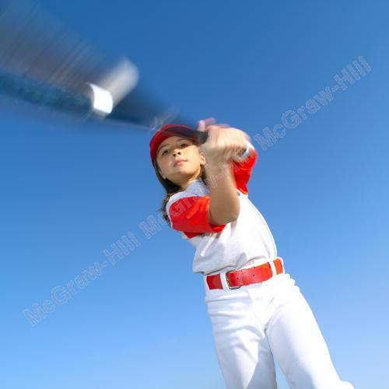

Curvilinear motion problem
The softball and the car both undergo curvilinear motion.
A particle moving along a curve other than a straight line is in curvilinear motion.

Slide 35

Curvilinear motion: position, velocity and acceleration
The position vector of a particle at time t is defined by a vector between origin O of a fixed reference frame and the position occupied by particle.
Consider a particle which occupies position P defined by at time t and P’ defined by at t + Δt,

Slide 36


Curvilinear motion: Position, velocity and acceleration
Instantaneous velocity (vector)
Instantaneous speed (scalar)

Slide 37


Curvilinear motion: Position, velocity and acceleration
Consider velocity of a particle at time t and velocity at t + Δt,
instantaneous acceleration (vector)
In general, the acceleration vector is not tangent to the particle path and velocity vector.

Slide 38


Rectangular component: Position, velocity and acceleration
When position vector of particle P is given by its rectangular components,
Velocity vector,
Acceleration vector,

Slide 39


Rectangular component: Position, velocity and acceleration
Rectangular components particularly effective when component accelerations can be integrated independently, e.g., motion of a projectile,
with initial conditions,
Integrating twice yields
Motion of projectile could be replaced by two independent rectilinear motions.

Slide 40

Problem 1
A projectile is fired from the edge of a 150-m cliff with an initial velocity of 180 m/s at an angle of 30°with the horizontal. Neglecting air resistance, find (a) the horizontal distance from the gun to the point where the projectile strikes the ground, (b) the greatest elevation above the ground reached by the projectile.

Slide 41

Problem 2
A baseball pitching machine “throws” baseballs with a horizontal velocity v₀. If you want the height h to be 42 in., determine the value of v₀.

Slide 42

Motion relative to a frame of translation
Designate one frame as the fixed frame of reference. All other frames not rigidly attached to the fixed reference frame are moving frames of reference.
Position vectors for particles A and B with respect to the fixed frame of reference Oxyz are
Vector joining A and B defines the position of B with respect to the moving frame Ax’y’z’ and
Differentiating twice,
velocity of B relative to A.
acceleration of B relative to A.
Absolute motion of B can be obtained by combining motion of A with relative motion of B with respect to moving reference frame attached to A.

Slide 43

Problem 1
Automobile A is traveling east at the constant speed of 36 km/h. As automobile A crosses the intersection shown, automobile B starts from rest 35 m north of the intersection and moves south with a constant acceleration of 1.2 m/s². Determine the position, velocity, and acceleration of B relative to A 5 s after A crosses the intersection.

Slide 44



Tangential and normal component
If we have an idea of the path of a vehicle, it is often convenient to analyze the motion using tangential and normal components (sometimes called path coordinates).

Slide 45
Tangential and normal component
y
ρ= the instantaneous radius of curvature
e_{n}
v= v e_{t}
e_{t}
x
The tangential direction (e_{t}) is tangent to the path of the particle. v is velocity vector of a particle is in this direction
The normal direction (e_{n}) is perpendicular to e_{t} and points towards the inside of the curve.
The acceleration can have components in both the e_{n} and e_{t} directions

Slide 46


Tangential and normal component
To derive the acceleration vector in tangential and normal components, define the motion of a particle as shown in the figure.
are tangential unit vectors for the particle path at P and P’. When drawn with respect to the same origin, and is the angle between them.

Slide 47


Tangential and normal component
With the velocity vector expressed as the particle acceleration may be written as
but
After substituting,
The tangential component of acceleration reflects change of speed and the normal component reflects change of direction.
The tangential component may be positive or negative. Normal component always points toward center of path curvature.

Slide 48

Tangential and normal component
Relations for tangential and normal acceleration also apply for particle moving along a space curve.
The plane containing tangential and normal unit vectors is called the osculating plane.
The normal to the osculating plane is found from
Acceleration has no component along the binormal.

Slide 49

Problem 1
A motorist is traveling on a curved section of highway of radius 2500 ft at the speed of 60 mi/h. The motorist suddenly applies the brakes, causing the automobile to slow down at a constant rate. Knowing that after 8 s the speed has been reduced to 45 mi/h, determine the acceleration of the automobile immediately after the brakes have been applied.

Slide 50

Problem 2
The tangential acceleration of the centrifuge cab is given by
where t is in seconds and a_{t} is in m/s². If the centrifuge starts from rest, determine the total acceleration magnitude of the cab after 10 seconds.

Slide 51




Radial and transverse components
By knowing the distance to the aircraft and the angle of the radar, air traffic controllers can track aircraft.
Fire truck ladders can rotate as well as extend; the motion of the end of the ladder can be analyzed using radial and transverse components.

Slide 52

Radial and transverse components
The position of a particle P is expressed as a distance r from the origin O to P – this defines the radial direction e_{r.} The transverse direction e_{θ} is perpendicular to e_{r}
The particle velocity vector is
The particle acceleration vector is

Slide 53
Radial and transverse components
We can derive the velocity and acceleration relationships by recognizing that the unit vectors change direction.
The particle velocity vector is
Similarly, the particle acceleration vector is

Slide 54
Radial and transverse components
The particle velocity vector is

Slide 55


Radial and transverse components
When particle position is given in cylindrical coordinates, it is convenient to express the velocity and acceleration vectors using the unit vectors
Position vector,
Velocity vector,
Acceleration vector,

Slide 56

Problem 1
Rotation of the arm about O is defined by θ = 0.15t² where θ is in radians and t in seconds. Collar B slides along the arm such that r = 0.9 - 0.12t² where r is in meters.
After the arm has rotated through 30º, determine (a) the total velocity of the collar, (b) the total acceleration of the collar, and (c) the relative acceleration of the collar with respect to the arm.

Slide 57
Problem 2
The angular acceleration of the centrifuge arm varies according to
where θ is measured in radians. If the centrifuge starts from rest, determine the acceleration magnitude after the gondola has travelled two full rotations.

Slide 58
Acknowledgement
NPTEL lectures on Engineering Mechanics
Beer & Johnston, Vector Mechanics for Engineers
Meriam & Kraige, Engineering Mechanics
Problems taken from internet sources
Timoshenko & Young, Engineering Mechanics

